Slide 1

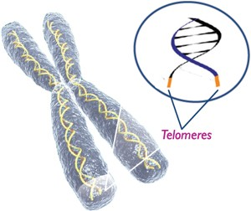
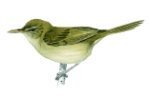
Altruism, infidelity and telomeres
David S Richardson
Lewis Spurgin

Slide 2
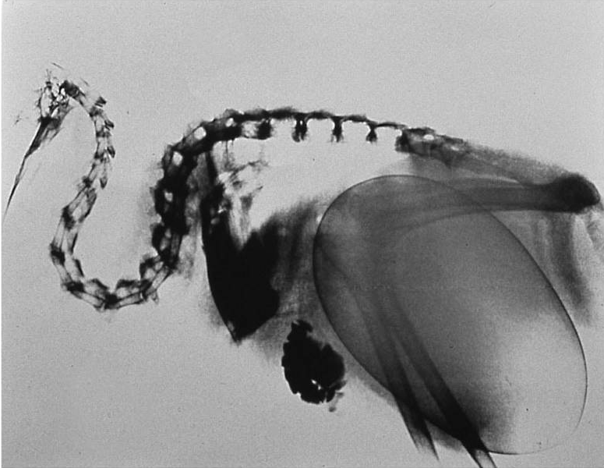
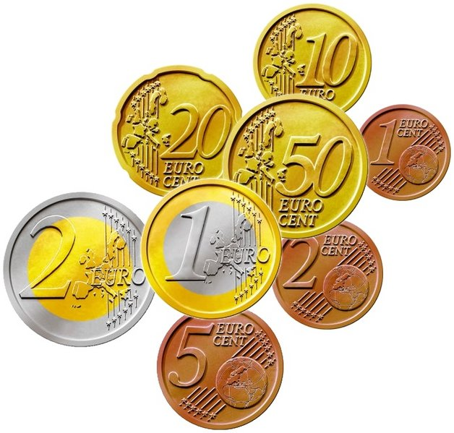
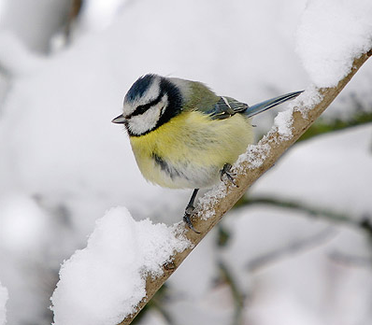
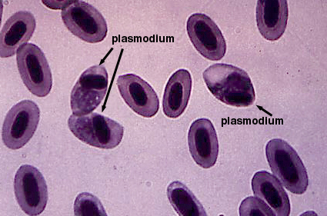
Cost and trade-offs in the struggle to survive and reproduce
Notes:
Because resources, and the time it take to acquire them, are limited, every organism has a finite amount it can use in its’ efforts to survive and reproduce. Resources spent on one area, cannot be spent on another,. Consequently organisms must trade off how best to spend their resources so as to maximise the benefits they gain.
Such trade-offs are central to our understanding of the evolution, for example why different life-history strategies evolve, i.e. why different organisms differ in aspects such as size, reproduction rate and lifespan, a fundamental part of biology.
The problem is that, although it is often relatively easy to assess the benefit of investment in an area, to understand trade-offs we also need to know the costs. Unfortunately, measuring such costs has proved to be extremely difficult, especially in wild living animals
What we need is universal measure – a generic currency with which we can measure and compare all these factors
Quantifying such costs using a universal measure would allow us to determine their relative impact within and between organisms

Slide 3
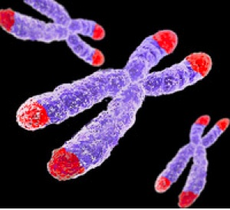
Telomeres
…TTAGGGTTAGGGTTAGGGTTAGGG… …AATCCCAAT CCCAATCCC AATCCC…
(TTAGGG)_{n}
in vertebrates
Inheritance
Replication History (age)
Oxidative Damage
Notes:
Specialized regions of repetitive DNA
Act as ‘caps’ to protect the ends of chromosomes
Prevent chromosome degradation or fusion during division (mitosis or mieosis

Slide 4

Telomeres as biomarkers of cost and quality in a wild population
If you measure telomere length in individuals and control for chronological age:
= Marker of biological ageing
If you isolate telomere shortening during specific experiences:
= Biomarker of the costs of such experiences
If you control for age and telomere shortening factors:
= Measure of individual quality
Notes:
The idea?

Slide 5
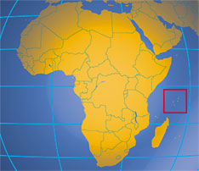
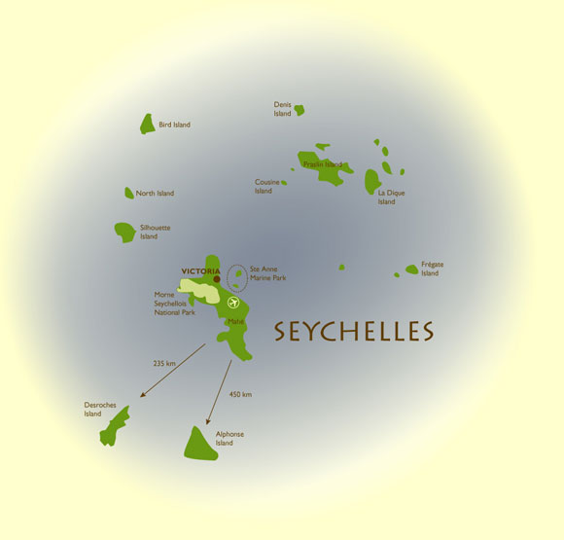
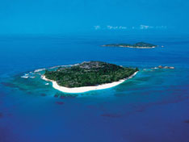
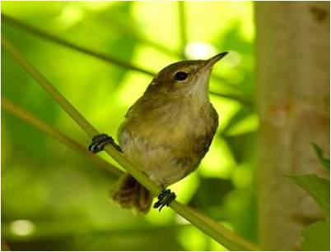



]
Seychelles Warbler
Acrocephalus sechellensis
ICBP

Slide 6

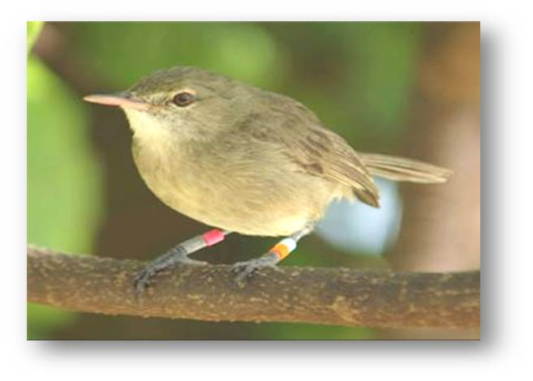
The SW system: a closed population
Cousin island (studied since 1985)
Small, isolated and enclosed population
> 97% birds colour ringed
Repeatedly blood sampled since 1994
Exact chronological age known
18 year pedigree being completed
Life history parameters known
Other experiences – e.g. malaria infection
Notes:
Small, isolated and enclosed population, >97% birds colour ringed ,
Inititally bled and rung as chicks or fledglings
Exact chronological age known,
Life history parameters known, Other experiences – e.g. infection etc , Genetic parameters

Slide 7
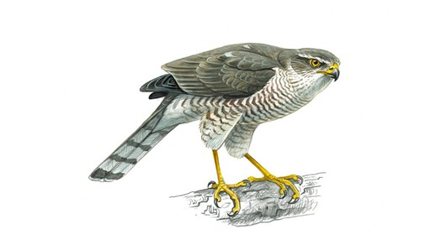
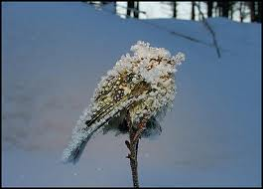

The SW system: mostly intrinsic mortality
x
x
x

Slide 8
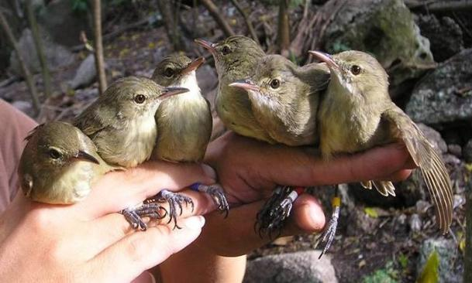
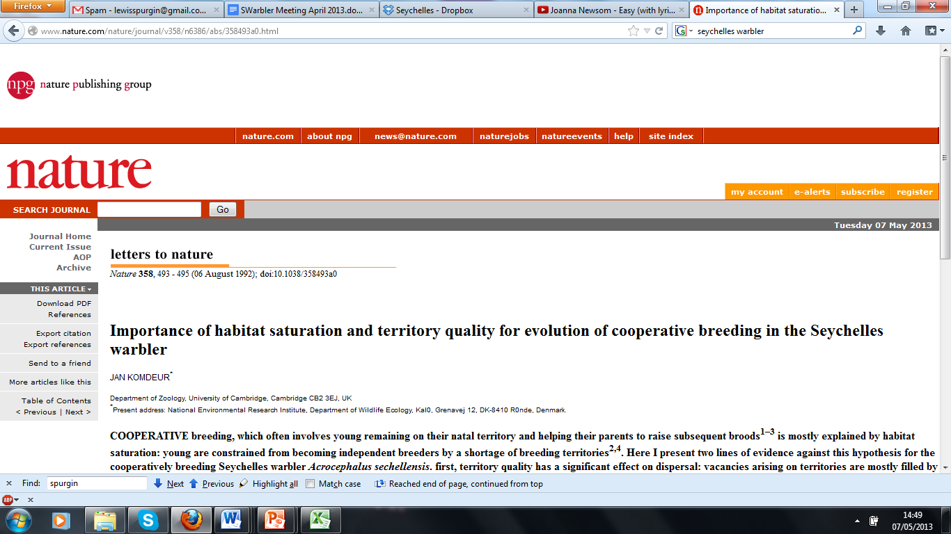
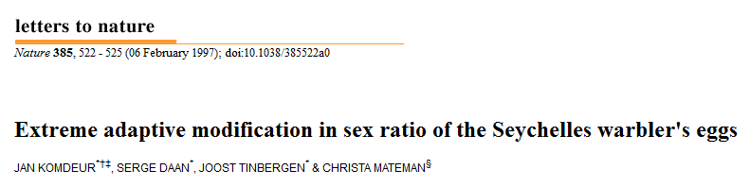
Understanding fundamental biological questions
Altruism
The evolution of cooperative breeding
Dominant pair
subordinates
+
offspring
Costs and Benefits
Notes:
Need to emphasis that to really understand these things we need to understand the costs as well as the benefits

Slide 9
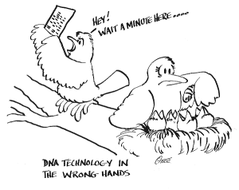
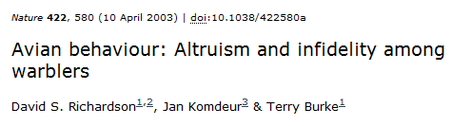
Infidelity The benefits of (extra-pair) mate choice
Understanding fundamental biological questions

Slide 10
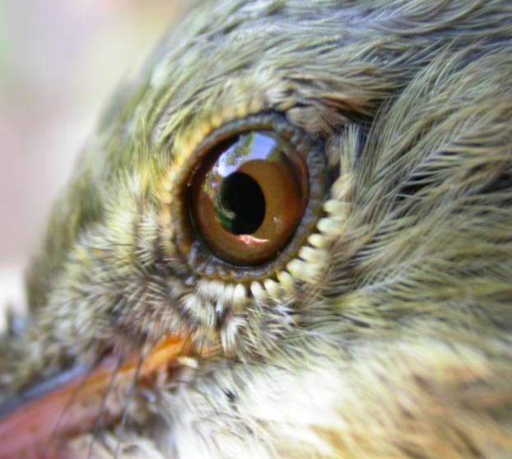
Overall Aims
Assess individual variation in telomere length/shortening
Are telomere dynamics linked to survival / longevity (Biological ageing)
How strategies/experiences affect telomere shortening (Generic currency)
If individuals differ in response to these factors (Individual quality)

Slide 11

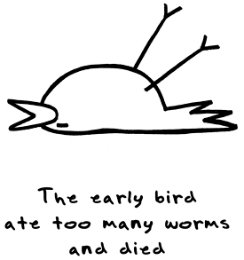
Results: adult telomere length
Adult telomeres shorten with age
Age: t_{1,211.6} =-3.88, P<0.0001
REML model with bird identity as random effect, R² =0.26
Loss = 120kb ± 30.1 SE per year
Length predicts survival to next year
Independent of their age
Telomere: χ²=9.62, P<0.01
Age: χ²=0.64, P=0.42
Length predicts post sampling lifespan
Last sample used for all individuals
Age χ²=6.35, P<0.05
Telomeres χ²=3.83, P<0.05
Notes:
The slope within individuals (black line) was not significantly different to the slope between individuals (dotted line). To analyse whether the relationship between telomeres and age was comparable within and between individuals, we split the age variable into two terms for each bird: the mean age (ß_{B}; Fig. 1c); and deviation from the mean age (Δ age or ß_{W}; Fig. 1d).
Within and between individual slopes did not significantly differ (F_{1,369} = 0.45, P=0.50).

Slide 12
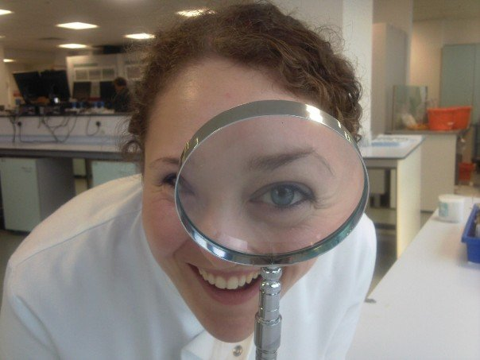
Dr Emma Barrett

Slide 13
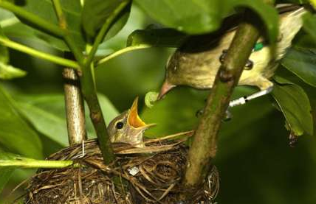
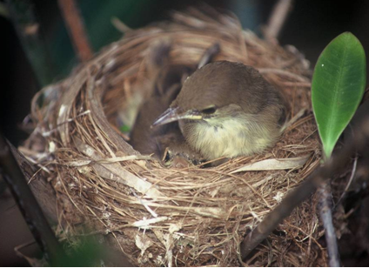
In early life
Notes:
telomere length is disproportionally shortened during juvenile development likely because of high levels of mitotic and oxidative stress.

Slide 14
Telomere dynamics in the Seychelles warbler Conclusions so far:
Individual variation in telomere length/shortening rate
Telomere dynamics predict short and long term survival in adults
Rapid telomere shortening in early life
Early life telomere shortening predicts survival
Notes:
Critical first to show that biological aging is correlated to tl or troc

Slide 15
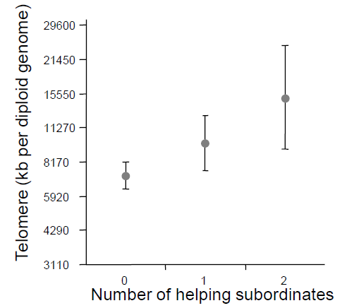
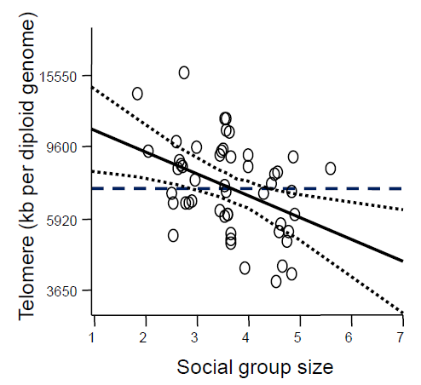
Telomere shortening in juveniles in relation to number of helpers at the nest
Notes:
Controlling for post-hatching age and sex of chicks, we found that the number of helpers had a positive relationship with telomere length - whereas local density had a negative effect on telomere length.
There was no effect of natal territory quality, year, or season of birth on telomere lengths at any age-class.

Slide 16
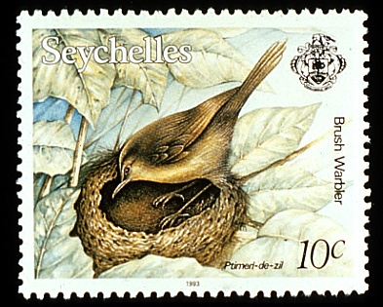
Recruitment into the breeding population
Telomere length predicts time to gaining dominant position
χ² = 3.79, DF=1, N = 128, P = 0.05
Notes:
Explain the dominant breeding positions situation
We assessed the relationship between telomere dynamics and the age at which they reached dominant breeding position. Of the 128 birds that survived to adulthood, and were not translocated, a quarter of the birds never gained a dominant breeding position (33 birds). Chick telomere lengths, along with size and number of helpers in the natal territory, strongly predicted the amount of time it took to gain a dominant breeding position in both sexes.
Our results provide the first clear and unambiguous evidence of a relationship between telomere length and social status in the wild, and substantiate the prediction that telomere dynamics can act as an indicator of individual quality when exploring life-history questions in natural conditions.

Slide 17

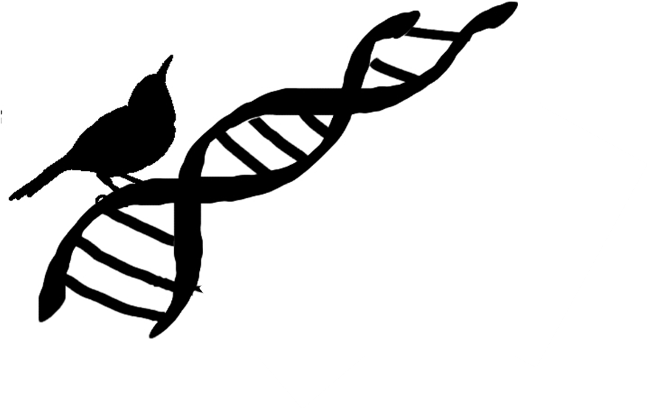
Thanks!
Pat Monaghan, University of Glasgow
Winnie Boner, University of Glasgow
Simon Verhulst, University of Groningen
Seychelles Warbler Study Group
Emma Barrett - UEA
Jan Komdeur University of Groningen
Terry Burke, University of Sheffield
All the other warbler researchers !!

Slide 18
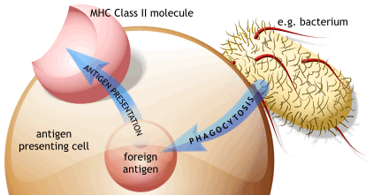
Telomere shortening in relation to:
Life history components:
Breeding status
Breeding effort
Environmental components:
Territory quality
Local breeding density
Malaria infection status
Genetic components
Inbreeding
MHC characteristics
Toll like receptor variation
Notes:
Critical first to show that tl or troc is correlated to biological aging

